Slide 1
SHELL Programming
Zhaojun Chen

Slide 2
Table of contents
What is SHELL
Command-line Interpreter
Test and Loop
Basic Commands
Shell Script

Slide 3
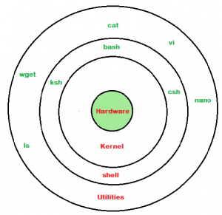
What is SHELL
1. A shell is special user program which provide an interface to user to use operating system services.
2. Shell accept human readable commands from user and convert them into something which kernel can understand.
3. It is a command language interpreter that execute commands read from input devices such as keyboards or from files.
4. The shell gets started when the user logs in or start the terminal

Slide 4
Command-line Interpreter
Shell command lines consist of one or more words, which are separated on a command line by blanks or TABs.
Command Options Parameters
IFS(Internal Field Separator), a specific shell variable is used to split command line into words, the default value is <space><tab><newline>.
Single Quotes or Hard Quotes
strip all characters within the quotes of any special meaning they might have
Double Quotes or Soft Quotes
Preserve the literal value of enclosed characters except ‘$’ ‘\’ and ‘`’
A=B\ C
What is the result of echo ‘”$A”’ and echo “’$A’”
Backslash
Mark these special characters so that they are not interpreted by the shell

Slide 5
More in command-line interpreter
Brace expansion
An optional preamble, followed by a series of comma-separated strings between a pair of braces, followed by an optional postscript.
Tilde Expansion
All words between ‘~’ and 1st ‘/’ is considered as tilde-prefix. ~[tilde-prefix] is replaced with home directory associated with the login name(tilde-prefix) or $HOME env.
Command Substitution
Shell run $(command) in an subshell and replace the command with output of a command.
Process Substitution
Allows a process’s input or output to be referred to as a filename.
<(command list) or >(command list)
Filename Expansion
Shell scans each word for the characters ‘*’, ‘?’, and ‘[’, replace then with an alphabetically sorted list of filenames matching the pattern

Slide 6
command-line interpreter examples
1. Brace expansion
*eselnts1466> touch ~/tmp/a{d,c,b}e
ade ace abe
*eselnts1466> bash -c 'echo {1..10}‘
2. Tilde expansion
*eselnts1466> ~eezhach/bin/tcdef
3. Command Substitution
*eselnts1466(master)> bash -c 'line1=$(cat ~/bin/tcdef|head -n 1); echo "$line1“’
#!/bin/bash
*eselnts1466(master)> bash -c 'a=1;((b=$a+1)); echo $b’
2
*eselnts1466(master)> bash -c 'a=1; b=$((a+1)); echo $b'
2

Slide 7
command-line interpreter examples
4. Process Substitution
*eselnts1466> bash -c ' bash -c 'echo <(ls ~/bin) <(ls -l ~/bin)'’
/dev/fd/63 /dev/fd/62
*eselnts1466> bash -c 'diff <(ls ~/bin) <(ls -l ~/bin)‘
*eselnts1466(master)> bash -c 'while read nu; do echo $nu; done < <(cat ~/tmp/222)’
1st ‘<‘ is input redirection
2nd ‘<‘ is process substitution.
5. File name expansion
‘*’, matches any string, including the null string
‘?’, matches any single character
‘[…]’, matches any one of enclosed characters.
‘./’, current directory
‘. file’ source file
‘../’ parent directory

Slide 8
Test
if..then..else Syntax
if < condition > or <condition1 &&/||/-a/-o condition2>
then
command list
else
command list
fi
Condition Syntaxes
1. if [ condition ]; ……
2. test condition;…..
3. if [[ condition ]]; ….
4. if ((arithmetic conditions )); ….

Slide 9
Test
File-based conditions
[ -e existingfile ] | file ‘existingfile’ exists.
[ -d directory ] | file ‘directory’ exists and is a directory.
[ -f regularfile ] | file ‘regularfile’ exists and is a regular file.
[ -r readablefile ] | file ‘readablefile’ exists and is readable to the script.
[ -w writeablefile ] | file ‘writeablefile’ exists and is writeable to the script.
[ -x executablefile ] | file ‘executablefile’ exists and is executable for the script.
[ newerfile -nt olderfile ] | file ‘newerfile’ was changed more recently than ‘olderfile’, or if ‘newerfile’ exists and ‘olderfile’ doesn’t.

Slide 10

Test
String-based conditions
Attention!
The "<" and “>"needs to be escaped within a [ ] construct
if [ “$1“ \< “$2” ]
or
if [[ “$1” < “$2 ]]
[ -z EMPTYSTRING ] | EMPTYSTRING is an empty string.
[ -n NONEMPTYSTRING ] | NONEMPTYSTRING has a length of more than zero.
[ STRING1 == STRING2 ] | STRING1 is equal to STRING2.
[ STRING1 != STRING2 ] | STRING1 is not equal to STRING2.
[ STRING1 \> STRING2 ] | STRING1 sorts after STRING2 in ASCII alphabetical order.
[ STRING1 \< STRING2 ] | STRING1 sorts before STRING2 in ASCII alphabetical order.

Slide 11
Test
Arithmetic (number-based) conditions
[ NUM1 -eq NUM2 ] | NUM1 is Equal to NUM2.
[ NUM1 -ne NUM2 ] | NUM1 is Not Equal to NUM2.
[ NUM1 -gt NUM2 ] | NUM1 is Greater Than NUM2.
[ NUM1 -ge NUM2 ] | NUM1 is Greater than or Equal to NUM2.
[ NUM1 -lt NUM2 ] | NUM1 is Less Than NUM2.
[ NUM1 -le NUM2 ] | NUM1 is Less than or Equal to NUM2.
(( NUM1 == NUM2 )) | NUM1 is equal to NUM2.
(( NUM1 != NUM2 )) | NUM1 is not equal to NUM2.
(( NUM1 > NUM2 )) | NUM1 is greater than NUM2.
(( NUM1 >= NUM2 )) | NUM1 is greater than or equal to NUM2.
(( NUM1 < NUM2 )) | NUM1 is less than NUM2.
(( NUM1 <= NUM2 )) | NUM1 is less than or equal to NUM2.

Slide 12
Test
Exit Status of Command
1. ‘$?’ reads the exit status of the last command executed.
2. After a function all or script, ‘$?’ gives the exit status of the last command in function/script, or the exit code of explicitly ‘return’ statement.
3. 0 on success or an integer in the range 1 - 255 on error.
Compound Comparison
[ -f try.py ] && file try.py
file try.py >/dev/null 2>&1 || echo ‘File not exit’
if [[ $UID -ne 0 && -u /usr/bin/passwd ]]; then echo "ok"; fi
if [ $UID -ne 0 -a -u /usr/bin/passwd ]; then echo "ok"; fi
if [ $UID -ne 0 ] && [ -u /usr/bin/passwd ]; then echo "ok"; fi
(( $a < 10 )) && (( $a > 0 )) && echo '0-a-10'

Slide 13
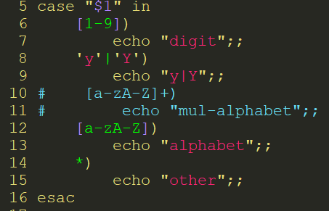
Case Statement
Case Statement
case "$1" in
[1-9])
echo "digit";;
'y'|'Y')
echo "y|Y";;
# [a-zA-Z]+)
# echo "mul-alphabet";;
[a-zA-Z])
echo "alphabet";;
*)
echo "other";;
esac

Slide 14
Pipe and Redirection
Pipe( command1 | command2)
Passes the output (stdout of a previous command to the input (stdin) of the next one *eselnts1466(master)> cat /etc/passwd |wc –l
Input and Output Redirection
1 standard output; 2 standard error; 0 standard input
ls /tmp/var >/tmp/111
~/bin/evrtd.sh >/dev/null 2>&1
while read nu; do
echo $nu
done < <(cat ~/tmp/222)’

Slide 15
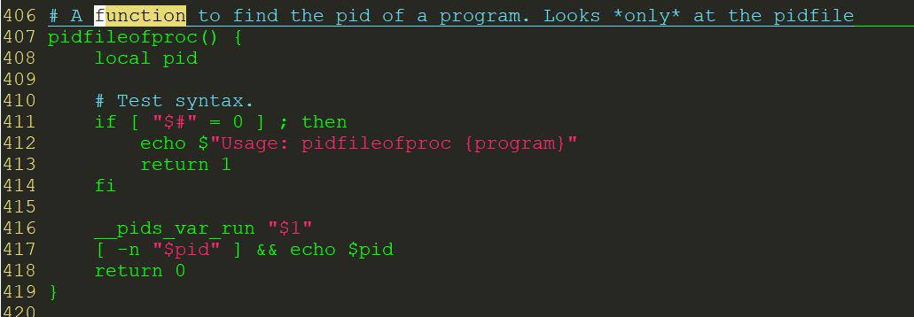
Function
Function Definition Format
[function] name() {
command list;
}
Call Function
function parameter1 parameter2
Get function example from /etc/init.d/functions

Slide 16
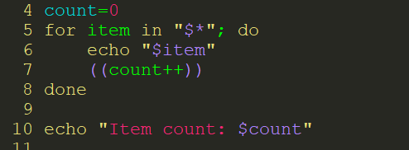
Positional Parameters
$0, $1, $2…
Positional parameters passed to function or script
$0, function name or script file name.
argument="$1" or argument_="$1"_
$#, parameter count.
$*, all of the positional parameters are seen as a single word.
$@, each parameter in argument list is seen as a separate word.

Slide 17
Loop
For Syntax
for arg in [list]; do
command list
done
While Syntax
while [condition]; do
command list
done
Until Syntax
until [condition]; do
command list
done

Slide 18
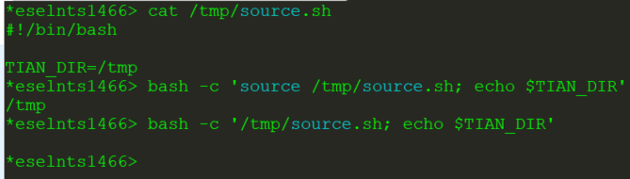
Basic Commands
which command, shows the full path of (shell) commands
man command, an interface to the on-line reference manuals
awk, cd, clear, cp, chmod, date +%w, du –sh, diff, dos2unix, grep –E, expr, file, find, getopts, head, id, kill, less, lsof, locate, ln, mkdir, more, mount, nice, netstat, ping, ps, read, rm, rpm, scp, sed, sort, source, sudo, tail, tcpdump, tee, tar, top, touch, tr, umask, unique, uptime, unzip, watch, who, wall
source command and subshell
source filename, import function/variables in filename to current shell.
./filename, run filename in a subshell

Slide 19
Shell Script
Create script file via vi/vim
Give the shell permission to execute it
chmod u+x filename
Run it
Debug
‘set –x’ at beginning of script
Capture signal
trap command signal
function error_handling()
{ ……..
}
trap error_handling SIGINT

